Slide 1
IR REMOTE CONTROL LEDS THROUGH ARDUINO
Presenter: Emmanuel NTIRENGANYA
Evelyne MUGOREWERA

Slide 2
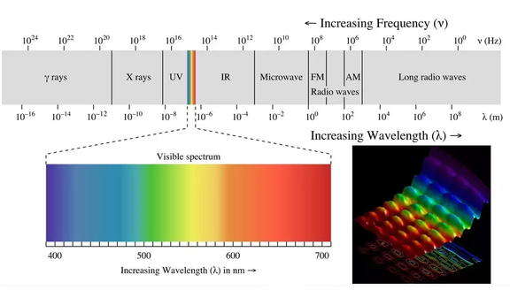
What is an IR?
Infrared radiation is a form of light similar to the light. The only difference between IR light and visible light is the frequency and wavelength.
https://www.quora.com/What-is-the-difference-between-infrared-light-ultraviolet-light-and-visible-light

Slide 3
Apparatus
Solderless Breadboard Model AD -12
Arduino uno
IR
Remote
Resistors 220Ω(3)
Leds(3)
Jumper wires

Slide 4
Objectives
It allows precise the user to control the LEDs by using remote or any appliances
It depends on covered distance of a remote

Slide 5
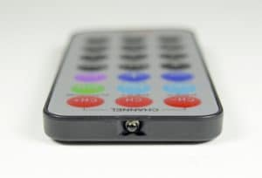
Remote
A typical infrared communication system requires an IR transmitter and an IR receiver

Slide 6
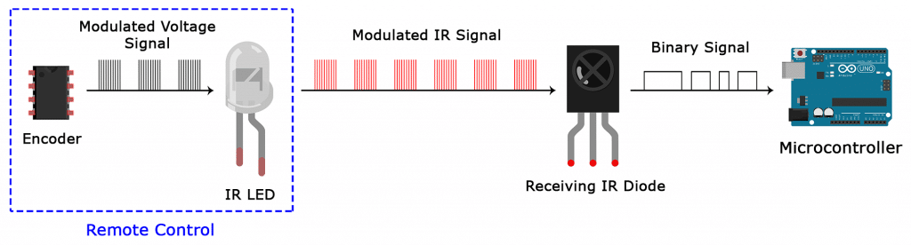
IR signal modulation
In IR signal modulation, an encoder on the IR remote converts a binary signal into a modulated electrical signal. This electrical signal is sent to the transmitting LED

Slide 7
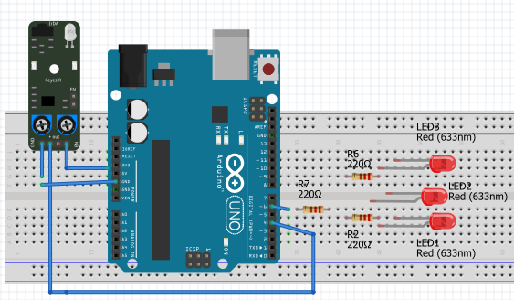
Fritzing connection Circuit

Slide 8
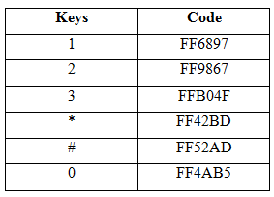
Keys of Remote used

Slide 9
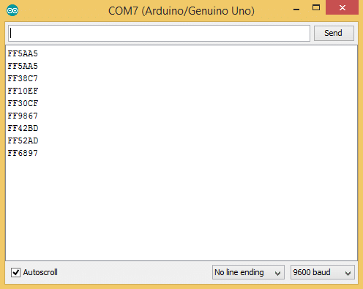
Decode IR

Slide 10
System’s coding
//Part I: coding, Start
#include <IRremote.h>
const int RECV_PIN = 4;
IRrecv irrecv(RECV_PIN);
decode_results results;
const int Led1 = 7;
const int Led2 = 6;
const int Led3 = 5;
void setup(){
irrecv.enableIRIn();
irrecv.blink13(true);
pinMode(Led1, OUTPUT);
pinMode(Led2, OUTPUT);
pinMode(Led3, OUTPUT);
}
//Part II: Coding, Suite
void loop(){
if (irrecv.decode(&results)){
switch(results.value){
case 0xFF6897: //Keypad button "1", Turn "ON" Led1
digitalWrite(Led1, HIGH);
}
switch(results.value){
case 0xFF42BD: //Keypad button "*", Turn "OFF"Led1
delay(2000);
digitalWrite(Led1, LOW);
}
switch(results.value){
case 0xFF9867: //Keypad button "2", Turn "ON" Led2
digitalWrite(Led2, HIGH);
delay(2000);}
switch(results.value){
case 0xFF4AB5: //Keypad button "*", Turn "OFF"Led2
digitalWrite(Led2, LOW);
}

Slide 11
Cont…
//Part III: Coding , Suite
switch(results.value){
case 0xFFB04F: //Keypad button "3", Turn "ON" Led3
digitalWrite(Led3, HIGH);
delay(2000);}
switch(results.value){
case 0xFF52AD: //Keypad button "*", Turn "OFF" Led3
digitalWrite(Led3, LOW);
}
irrecv.resume();
} // End

Slide 12
Conclusion
We learned how to display key presses on serial monitor .
Finally I showed you how to control the Arduino’s output with the remote

Slide 13
Thanks
End

